Slide 1
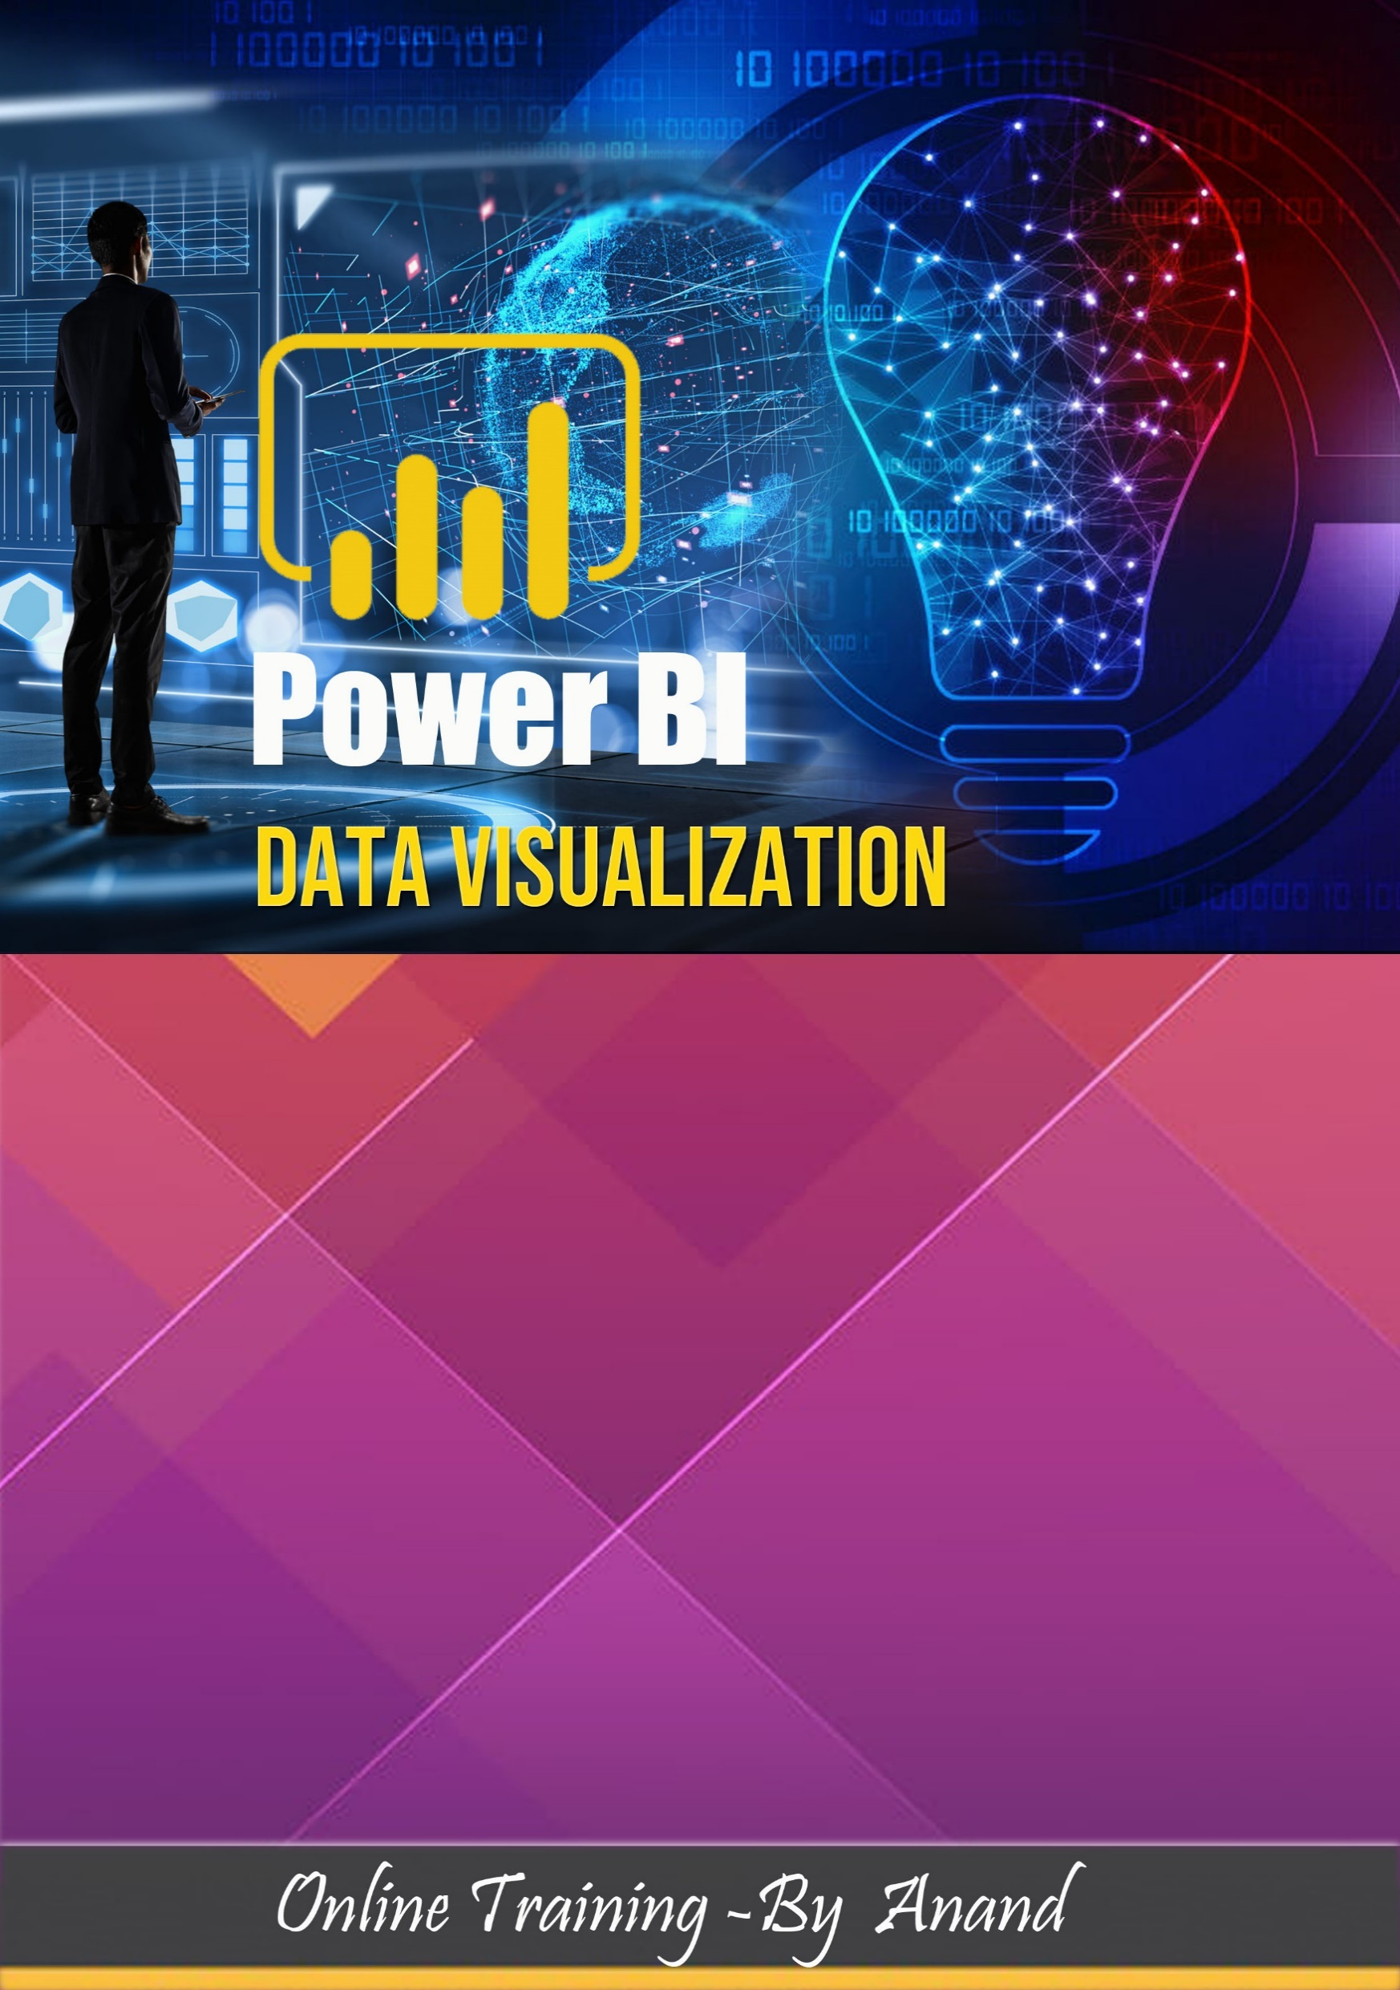
UpSkillSoft is a leading e-learning platform providing live instructor-led interactive online training. We cater to professionals and students across the globe in categories like Data Visualization and Cloud Computing , Business Analytics, NoSQL Databases, Mobile Technologies and Programming. We have an easy and affordable learning solution that is accessible to millions of learners. With our students spread across countries like the US, India, UK, Canada, Singapore, Australia, Middle East, Brazil and many others, we have built a community of over 1 million learners across the globe.
Courses : AWS , Tableau, Power BI , MSBI (SSRS,SSIS,SSAS),SQL,Azure

Slide 2

Introduction
About Course
Learn how to use Microsoft BI from beginner basics to advanced topics with a fully experiential workshop that has been designed by industry experts. Maximise the BI potential and use it to transform data into meaningful visualizations and analytics. You will learn the rich components of this tool including Modelling, Visualizations, exploring data with the dashboard, working with Excel, publishing and sharing data and the DAX functionality.
The curriculum has been designed keeping in view industry demands and you can be assured of landing Microsoft Power BI developer roles with the skills you get from this workshop. Data Visualization jobs are at an all- time high with organizations realising the importance of using data to drive their business and achieve their goals. Tools such as BI help achieve these business objectives and hence are widely endorsed by big and small companies. Enrol now and gain the skills that are so much in demand across the globe.
Module
Gain a 360° overview of how to explore and use Power BI to build impactful reports. In this course, you’ll go from zero to hero, as you discover how to use this popular business intelligence platform through hands-on exercises. You’ll first learn how to confidently load and transform data using Power Query and the importance of data models, before diving into creating visualizations using Power BI’s drag-and-drop functionality. You’ll also learn how to drill-down into reports and make your reports fully interactive. Lastly, you'll level-up your skills using DAX formulas (Data Analysis Expressions) to create customized calculated columns and fields to better analyze your data. Get started now. You've got the power!
What will Participants Learn?
This Course is designed to help you become a successful Data / business analyst. During this course, our expert instructors will train you to
Power BI architecture
Power view, power query, power pivot.
Installations and configurations associated with Power BI tool.
Reporting and visualizations using auto filters.
Hierarchies and drill-down reports.
Power Query Editor
Working with DAX Expressions.
Power BI deployment and cloud operations.
Advanced Power BI report/insights and subscriptions.

Slide 3
Who should take this training?
The Business Intelligence market is growing significantly across the world and such strong growth pattern followed by market demand is a great opportunity for the following IT Professionals.
Business Analysts
Data Analysts
Project Managers
Data Scientists
Statisticians and Analysts
Business Intelligence Managers
Graduates
How will Power BI Training help your career?
Power BI is emerging as one of the hottest trends in the Business Intelligence market. The Data Visualization tool has been gaining popularity in various companies and hence, the demand for Power BI experts in on the surge. We offer the best Power BI training with 10K+ satisfied learners
What are the pre-requisites for this course?
No Programing knowledge required
Having Basic Database knowledge is helpful but not mandatory
Program Features:
Live Online learning
Hands-On
Certified Trainers
Flexible Batch Timings
Live Session Recordings after class complete
Learn From industry Experts
Delivery Mode:
Online learning
One to One discussion

Slide 4
Key Learning Outcomes:
By the end of this Power BI training, you will be able to accomplish the following:
Power BI is a business analytics service provided by Microsoft. It provides interactive visualizations with self-service business intelligence capabilities, where end users can create reports and dashboards by themselves, without having to depend on any information technology staff or database administrator. Power BI provides cloud-based BI services - known as Power BI Services, along with a desktop-based interface called Power BI Desktop. It offers Data modelling capabilities including data preparation, data discovery and interactive dashboards.
Master concepts like Data Visualization and Integration
Learn about Power Pivot, Power View, Power Map etc
Understand DAX and SSBI
Use and implement Custom Visuals
Explore Power BI Q&A
Perform Data Binding and Formatting
Master Power BI Embedded and Workspace Collection
Understand and use Data Gateways, Content packs, Power BI Report Server

Slide 5
Module 01 – Power BI Introduction Tableau
Introduction to Business Intelligence
Introduction to Data Analysis & Data Visualization
What is Power BI?
Installing Power BI Desktop
How Power BI differs from other tools?
Starting with Power BI Desktop
Accessing data using Power BI
Power BI Architecture
Power Pivot,Power Query,Power View,Power Map
Module 02 - Data and Connections :
Navigating in the user interface
Data Manager
Data Load Editor
Data Model Viewer
Connect to Data Sources in Power BI
Connecting to Multiple CSV Files
Connecting to SQL Server Database, ODATA, Webservices,Web
Connecting to Multiple Files in Folders
Creating data relationships on differ data.
DirectQuery vs Import Data
Interacting with the user interface
Module 03 – Power Query for Data Transformation:
The Show Me Feature
Power Query Introduction
Query Editor
Query Editor Interface
Column Transformations
Data Type
Adding Column
Text Transformations
Number Column
Calculations Date and Time Calculations
Module 04 – Data Modelling in Power BI
Introduction to DAX
Calculated Columns
Measures Calculated
Tables Row Context vs Set Context
Advanced calculations using Calculate functions
Time Intelligence Functions

Slide 6
Module 05 – Power BI Charts
Line Chart
Bar Chart
Pie Chart
Table
Pivot Table
KPI Chart
Gauge Chart
Map Charts
Scatter Plot
Funnel Chart
Area/Stacked Area Chart
Donut Chart
Card/Multi Row Card
ArcGIS Maps
Waterfall Chart
R Script Visuals
Module 06 - Reports in Power BI :
Create a new Power BI report
The report editor in Power BI
Add a page to a Power BI report
Add a filter to a report in Power BI
Save a report in Power BI
About filters and highlighting in Power BI reports
How to use report filters
Analyze in Excel
Change how visuals interact in a report
Open a Power BI report in Reading View
Go from Reading View to Editing View in Power BI
Interact with a report in Editing View in Power BI
Aggregates (sum, average, maximum, etc.) in Power BI
Rename a report in Power BI
Page display settings in a Power BI report
Duplicate a report page in Power BI
Delete a page from a Power BI report
Rename a report page

Slide 7
Module 07 - Reports & Visualization
Types of visualization in a Power BI report
Custom visualization to a Power BI report
Download a custom visual from the gallery
Getting started with color formatting and axis properties
Change how a chart is sorted in a Power BI report
Move, resize, and pop out a visualization in a Power BI report
Drill down in a visualization in Power BI
Histograms
Basic Area chart
Combo Chart in Power BI
Customize visualization title, background, and legend
Customize X-axis and Y-axis properties
Doughnut charts in Power BI
Enhanced Scatter charts in Power BI
Funnel charts in Power BI
KPI Visuals
Radial Gauge charts in Power BI
Scatter Charts in Power BI
Slicers in Power BI
Tree Maps in Power BI
Waterfall charts in Power BI
Module 08 - Reports in Power BI :
Create a Power BI dashboard
Dashboard tiles in Power BI
Pin a tile to a Power BI dashboard from a report
Power BI publisher for Excel
Pin an entire report page to a Power BI dashboard
Data alerts in Power BI service
Add an image, text box, video, or web code to your dashboard
Edit a tile -- resize, move, rename, pin, delete, add hyperlink
Tips for designing a great Power BI dashboard
Print a dashboard, print a dashboard tile, print a report page
Display dashboards and reports in Full Screen mode
Display a dashboard tile in Focus mode
Featured dashboards in Power BI
Create a phone view of a dashboard
Add an image to a dashboard

Slide 8
Module 09 - Sharing Options
Publish from Power BI Desktop
Publish to Web
Share Dashboard with Power BI Service
Workspaces and Apps (Power BI Pro)
Content Packs (Power BI Pro)
Print or Save as PDF
Export Data from a Visualization
Publishing for Mobile Apps
Export to PowerPoint
Sharing Options Summary
Module 10 - Refreshing Datasets
Understanding Data Refresh
Personal Gateway (Power BI Pro and 64-bit Windows)
Replacing a Dataset
Troubleshooting Refreshing
Module 11 - Secure of Data in Power:
Row Level Security
Define roles and rules
Validating the role
Manage security on your model
Validating the role
Module 12 - Introduction to DAX:
Creating calculated columns
Creating calculated measures
Aggregation functions
Counting functions
Logical functions
Information functions
Text functions
Date functions
Filter Functions

